Slide 1

Data analysis and visualization using R
Zhengtao Xiao
8.28.2020
zhengtao.xiao@duke.edu

Slide 2





=
Muggles
Users have to reply on the functions that have been developed for them. The way to approach a problem constrained by how their developers thought to approach them. Users have to pay money to their constrained functions.
=
Wizard
Lots of functions or packages (spells) that developed by statistical researchers, but users can also create their own. Users don’t have to pay. Once experienced enough, users are almost unlimited in their ability to change their environment.

Slide 3

Learning R ……

Slide 4
History of R
R initially written & released as an open source software by Ross Ihaka and Robert Gentleman during 90s.
Since 1997: R Development Core Team ~ 37 people & thousands of code writers and statisticians share their libraries!
Advantages of R
An interpreted computer language
R is very powerful for data manipulation, statistics, and graphics.
Fast and free
Active user community
Force you to think about your analysis
Disadvantages of R
Not user friendly, very simple GUI.
No commercial support
Easy to make mistakes.

Slide 5
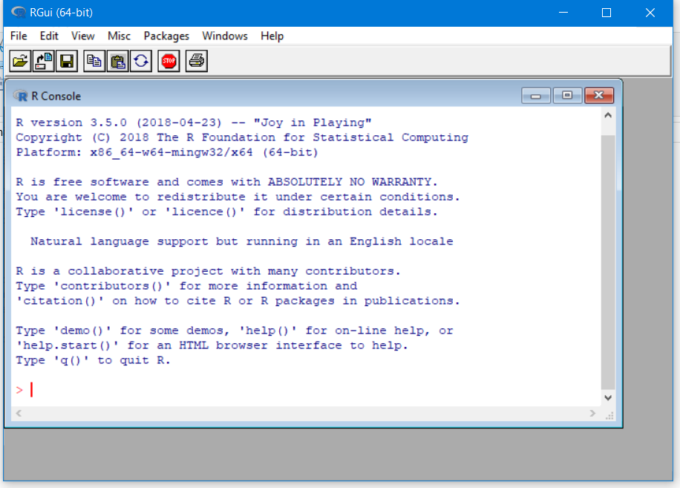
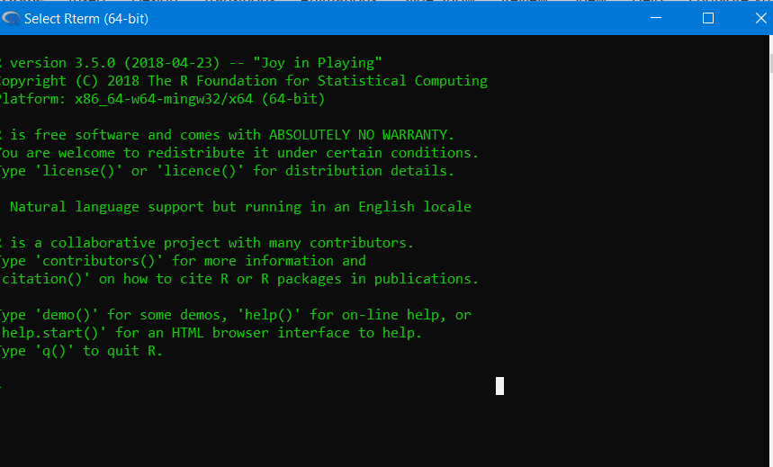
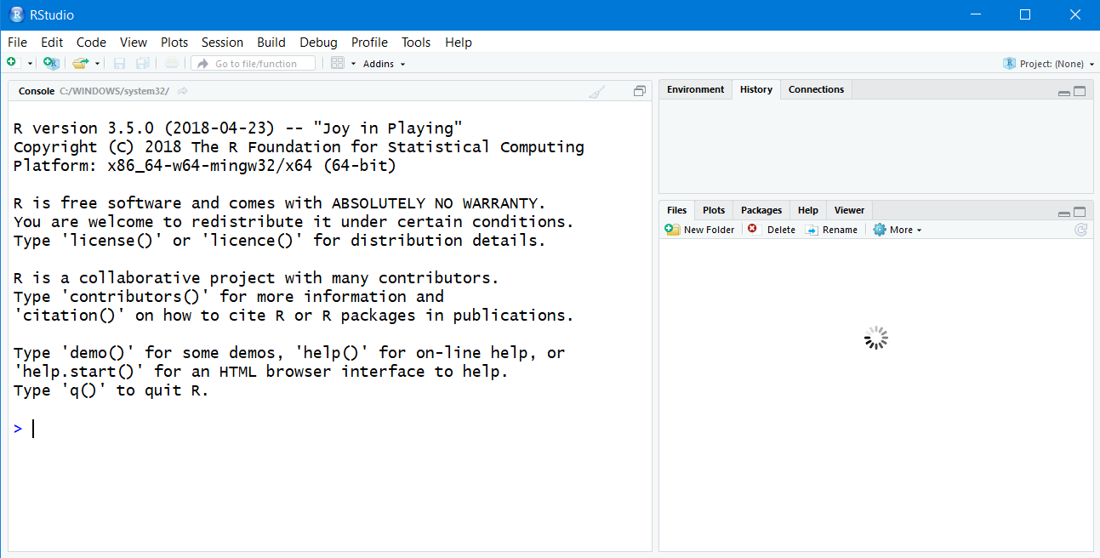
Download R
https://www.r-project.org/
R workplace
R console
R terminal
Rstudio: an integrated development environment (IDE) for R

Slide 6
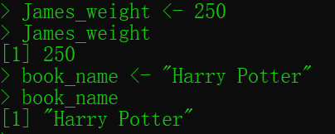
Values in R
Numeric: 1
Character: “abc”
Logical: TRUE FALSE
Date: "2020-08-25"
R has objects
can be assigned using “<-” or “=”. Object can be a value, object, or function.
Try to assign an object:

Slide 7
How R store the values
Basic data structures in R
Vector
List
Matrix
Data Frame
Elements should be the same type
(numeric, character, logical or date)
Elements can be the same or different types
Same type
Can be multiple types

Slide 8
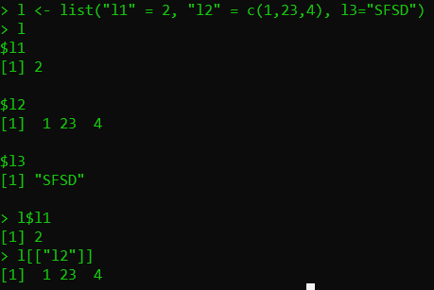
Create and extract an object
Vector: an ordered collection of single values of the same type, elements are accessed by the index.
<-
is equal to
=
a <- 34
b <- c(2, 4, 5)
b[1]
fruits <- c(“apple”, “orange”, “strawberry”)
Fruits[1] # object name is case sensitive
? What if I create a vector contains different types of values
# c means concatenate
List: an ordered collection of elements of different type, elements are accessed by their names

Slide 9
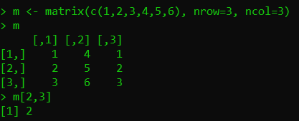
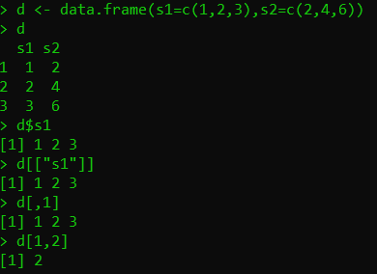
Create and extract object
Matrix: a rectangular table of data of the same type
[row index, column index]
Data frame: a rectangular table; each column has the same type, but different columns may have different types.
Three ways to get the first column

Slide 10
R function
Function is like a box
Function
Input
Output
do_this(input, parameters)
c, list, matrix, data.frame, mean(a)
How to get more information about a built-in function: ?, help
How to define my own function:
cal_square <- function(x) {
y <- x * x
return (y) ## can be omitted.
}
cal_square(2)

Slide 11

Now let's play with R

Slide 12
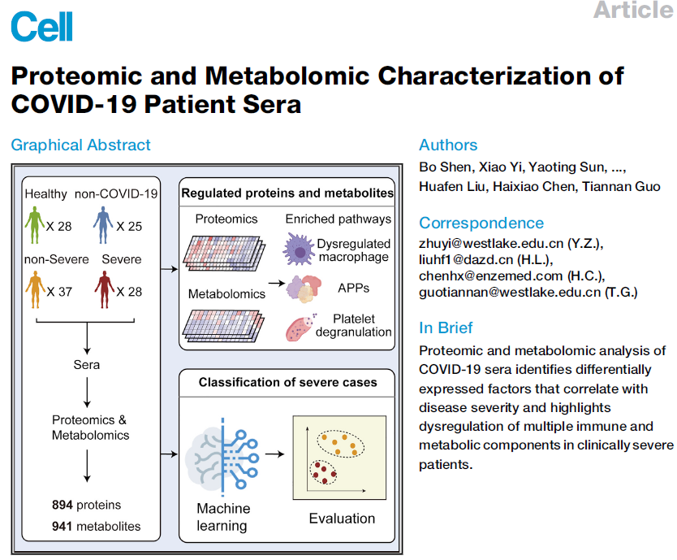
Practice dataset:

Slide 13
Using R to perform analysis and visualize data
General data analysis flow
Read data
Read the dataset into R
Log2 transformation
Analyze the data (t-test)
Graphing and export
Tidy
Transform
Analysis
Visualization

Slide 14
Read the dataset into R
Command: read.csv (for .csv file)
read.table (for .txt file)
read_excel (for excel file)
.csv: separated by “,”
.txt: the columns separated by “ ” or “\t”
Need to load the readxl package
Parameters:
Filename: local file or an url
header: TRUE
row.names: 1 (use the first column strings as the row name of dataset)
How to get your working directory?
How to change your working directory?
Write the full path of a file in windows system and unix like system.
More information about absolute path and relative path.

Slide 15
Read the dataset into R
use “getwd()” to get the default R working directory.
“setwd(path)” to change it
Read the dataset and store it into a variable (for example mydata):
covid19_data <- read.csv(“RawData_plasma metabolites.csv”, header=TRUE, row.names=1)
or
covid19_data <- read.csv(“https://raw.githubusercontent.com/zhengtaoxiao/NCSU_R/master/ RawData_plasma metabolites.csv”, header=TRUE, row.names=1)
Change the data type from dataframe to matrix
covid19_data <- data.matrix(covid19_data)

Slide 16
2. Log2 transformation
Inspecting your dataset: View(covid19_data)
See also : head(covid19_data)
tail(covid19_data)
First 10 rows
Last 10 rows
Check the dimension of the data: dim
Log2 your dataset: covid19_log2_data <- log2(covid19_data+1)
The distribution of metabolites in a patients before and after log2 transformation:
hist(covid19_data)
hist(covid19_log2_data)

Slide 17
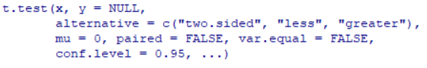
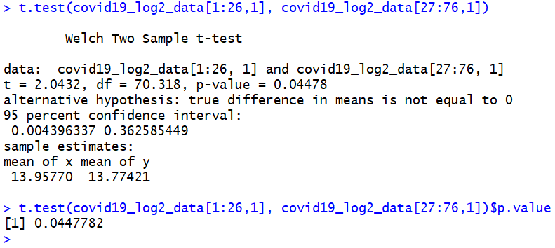
3. Analyze the data
Using of the t-test function in R
Example of t.test for first metabolite
Healthy people
Infected patients
The result of t.test is a list. Using the “$” to get the elements.

Slide 18
3. Analyze the data
We can define function to perform t-test on specific metabolite and return p-value
Function is like a box
Function
Input
Output
metabolite
p-value
myttest <- function(idx){
res <- t.test(x = covid19_log2_data[1:26, idx],
y = covid19_log2_data[27:76, idx])
return (res$p.value)
}
myttest(1)

Slide 19

3. Analyze the data
Perform test for all metabolites
pvals <- c()
for(i in 1:nrow(covid19_log2_data)){
p <- myttest(i)
pvals <- c(pvals,p)
}
1:10 generates a vector c(1,2,3,4,5,6,7,8,9,10). Here 1:nrow(mydata) return the row indexes of mydata
Using of command sapply to perform t-test on each row
pvals <- sapply(X=1:ncol(covid19_log2_data),FUN=myttest)
nrow return the number of rows of a matrix or dataframe

Slide 20
3. Analyze the data
Let’s calculate the log2 fold change using the sapply
cal_log2fc <- function(idx){
control_mean <- mean(covid19_data[1:26,idx])
infected_mean <- mean(covid19_data[27:76,idx]
return log2(infected_mean / control_mean) }
log2_fcs <- sapply(X=1:ncol(covid19_data), FUN=cal_log2fc)
Learn more similar functions: apply, lapply
Return a list
Input is an array or matrix

Slide 21
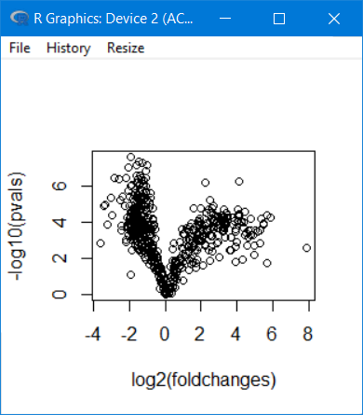
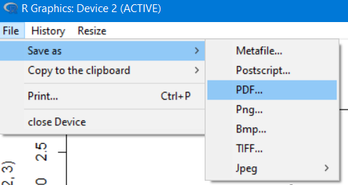
4. Graph and export: Volcano plot
Command: plot
Parameters:
x (x axis)
y (y axis)
plot(x = log2_fcs , y = -log10(pvals))
Log2 transformed values are easy to understand: >0 means increased; <0 decreased;
-log10 transformed p-values: 0.1, 0.01, 0.001, 0.0001 1, 2, 3, 4
Export the graph

Slide 22
4. Graph and export: the t-test result
Command: write.csv (for .csv file)
write.table (for .txt file)
.csv: separated by “,”
.txt: the columns separated by “ ” or “\t”
Parameters:
Data: matrix or data frame
Filename: the name of file, default is print to console
Read the dataset and store it into a variable :
write.csv(cbind(log2_fcs, pvals), “ttest_result.csv”)
Using cbind to combine vectors by column and generate a matrix

Slide 23
Powerful package: ggplot
Focus on the analysis and data, using ggplot to create the graph quickly.
You provide the data, tell ggplot2 how to map variables to aesthetics, what graphical primitives to use.
install.packages(“ggplot2”)
library(ggplot2)
group_data <- read.csv("group_info.csv", header=T,row.names=1)
plot_data <- data.frame(value=covid19_data[,1], + group=group_data[,1])
ggplot(plot_data, aes(x=group, y=value)) +
geom_boxplot()
## try geom_col(), geom_violin(), geom_point(), geom_jitter()

Slide 24
ggplot: Add error bars to a bar
ggplot(plot_data, aes(x=group, y=value,fill=group)) +
stat_summary(geom = "bar", fun = mean)+
stat_summary(geom = "errorbar", fun.data = mean_se, width=0.5)

Slide 25
ggplot: more groups
plot_data2 <- covid19_data[,c("Citric.acid","Isocitric.acid",
"Fumaric.acid", "Succinic.acid")]
head(plot_data2)
library(reshape2)
plot_data2 <- melt(plot_data2) #Convert an object
head(plot_data2)
plot_data2$group <- rep(group_data[,1],4)
ggplot(plot_data2, aes(x=group, y=value, fill=variable)) +
stat_summary(geom = "bar", fun = mean, position= "dodge")+
stat_summary(geom = "errorbar", fun.data = mean_se, position="dodge")

Slide 26
ggplot: more groups, using the relative intensities
for(m in unique(plot_data2$variable)){
control_mean <- mean(plot_data2[(plot_data2$variable == m) & (plot_data2$group=="CONTROL"),"value"])
plot_data2[plot_data2$variable == m, "relative"] <-
plot_data2[plot_data2$variable == m, "value"] / control_mean
}
ggplot(plot_data2, aes(x=variable, y= relative, fill=group)) +
stat_summary(geom = "bar", fun = mean, position= "dodge")+
stat_summary(geom = "errorbar", fun.data = mean_se, position="dodge") +
scale_fill_manual(values = c("#ffbfbf","#ff4040","#bf0000","#6f0000"))

Slide 27

More powerful packages

Slide 28
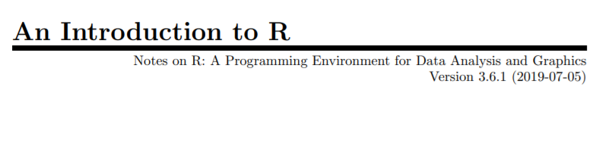

Any questions:
https://cran.r-project.org/doc/manuals/r-release/R-intro.pdf
https://www.r-project.org/help.html
zhengtao.xiao@duke.edu

